Slide 1


Consumer Goods Ad_Hoc Insights Presented by Prateek Sood

Slide 2
Problem Statement:
Atliq Hardwares (imaginary company) is one of the leading computer hardware producers in India and well expanded in other countries too.
However, the management noticed that they do not get enough insights to make quick and smart data-informed decisions. They want to expand their data analytics team by adding several junior data analysts. Tony Sharma, their data analytics director wanted to hire someone who is good at both tech and soft skills. Hence, he decided to conduct a SQL challenge which will help him understand both the skills.

Slide 3

Objective
Analyze key business data using SQL.
Provide actionable insights.
Support Atliq Hardware’s strategic decision-making.
Provide Insights for 10 ad hoc requests.

Slide 4
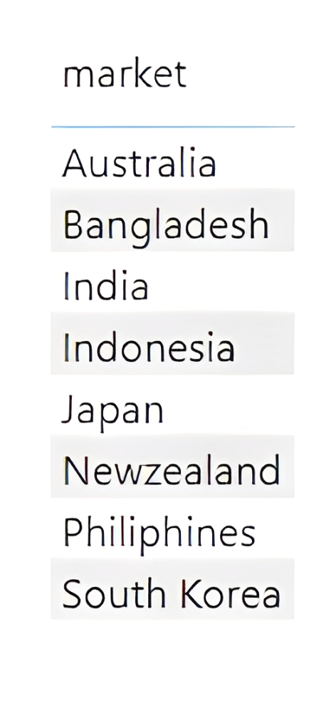
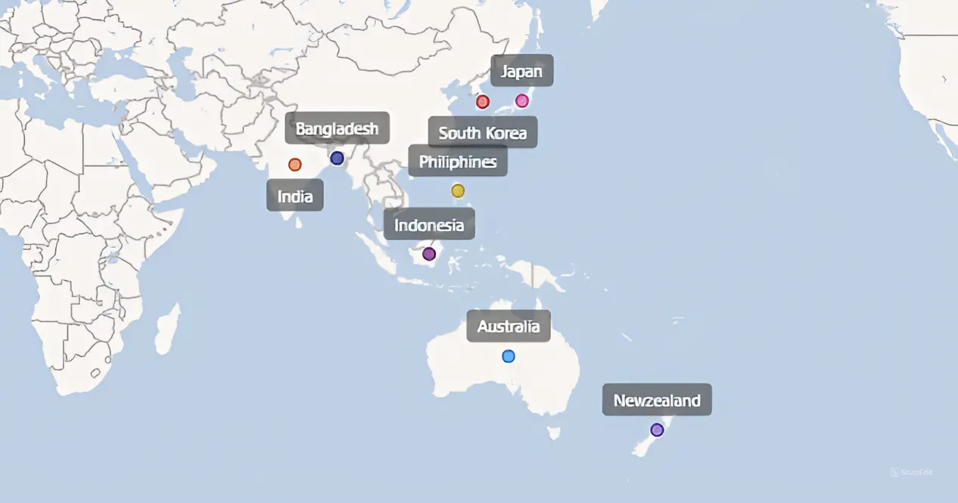
Question 1:
Provide the list of markets in which customer "Atliq Exclusive" operates its business in the APAC region.
Output:

Slide 5
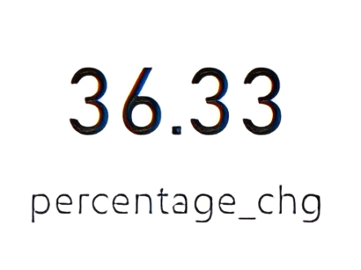
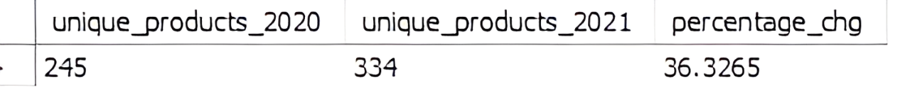
Question 2:
What is the percentage of unique product increase in 2021 vs. 2020? The
final output contains these fields,
unique_products_2020
unique_products_2021
percentage_chg
Output:

Slide 6
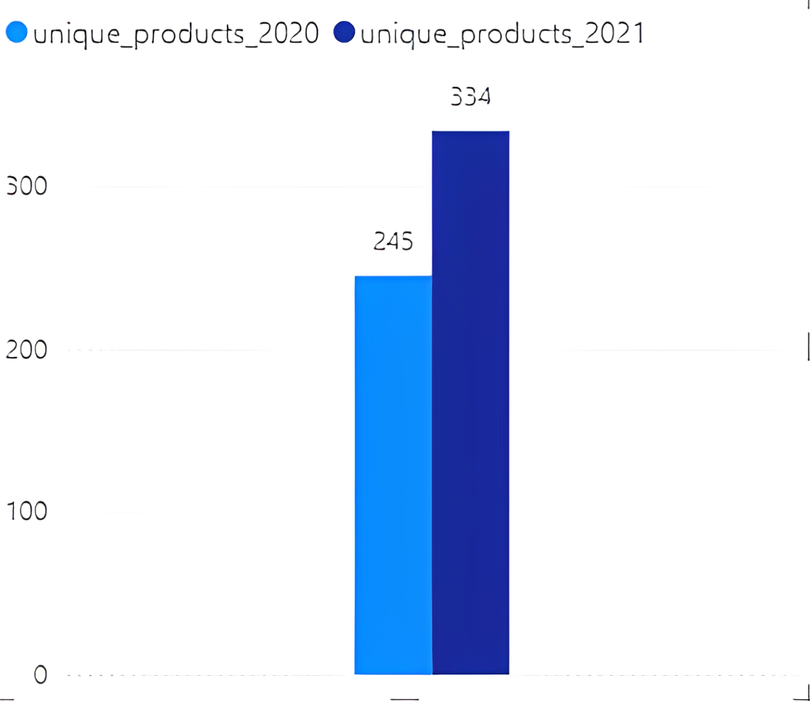
Insights:
*There was a 36.33% increase in the number of unique products from 2020 to 2021. This suggests that the product range expanded considerably during this period.
* The increase in unique products could indicate that the company was actively diversifying its product offerings, possibly to cater to a broader market or to meet increased demand.

Slide 7
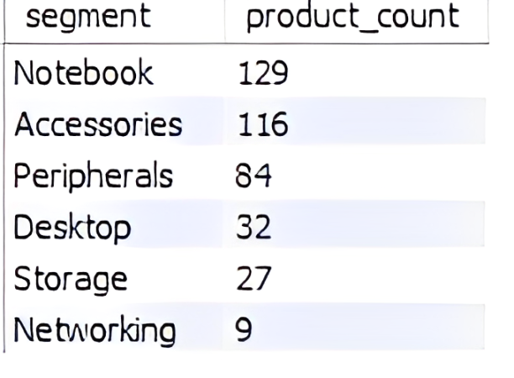
Question 3:
Provide a report with all the unique product counts for each segment and sort them in descending order of product counts. The final output contains 2 fields,
segment
product_count
Output:

Slide 8
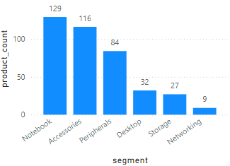
Insights:
*The Notebook segment has the highest product count with 129 unique products. This suggests that the company is heavily focused on the Notebook segment, possibly due to high demand .
*With 116 products, the Accessories category is also very important. The company offers a wide range of accessories, which could help boost sales of its main products like Notebooks and Desktops.
*The Storage (27 products) and Networking (9 products) categories have fewer products. The company could look into expanding the Storage and Networking categories if there's potential for growth.

Slide 9
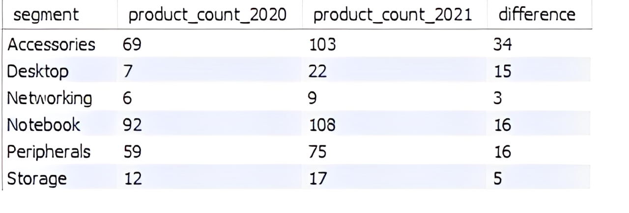
Question 4:
Follow-up: Which segment had the most increase in unique products in 2021 vs 2020? The final output contains these fields,
segment
product_count_2020
product_count_2021
difference
Output:
Insights:
The Accessories segment had the most significant increase in unique products from 2020 to 2021, with a difference of 34 products (from 69 in 2020 to 103 in 2021) whereas Networking and Storage has least increase .

Slide 10
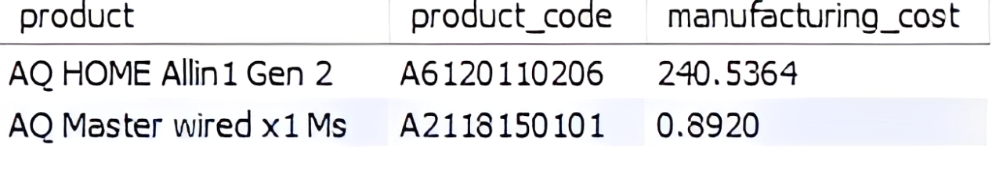
Question 5:
Get the products that have the highest and lowest manufacturing costs. The final output should contain these fields,
product_code
product
manufacturing_cost
Output:

Slide 11
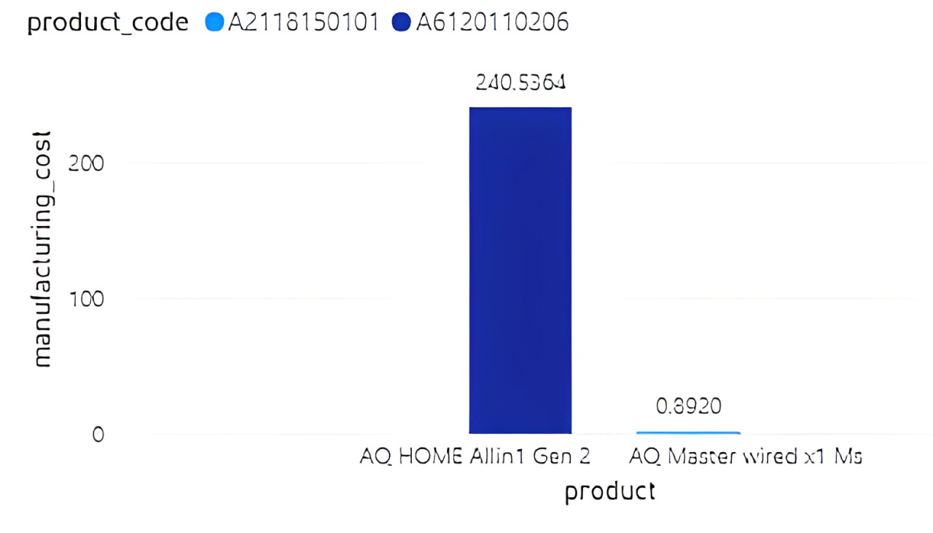
Insights:
*The AQ HOME Allin1 Gen 2 has the highest manufacturing cost at 240.5364. This suggests it is a complex or premium product, likely involving more expensive materials or processes during its production.
* The AQ Master wired x1 Ms has the lowest manufacturing cost at just 0.8920. This indicates it is a relatively simple or basic product, possibly produced in large quantities with cost-effective materials or processes.

Slide 12
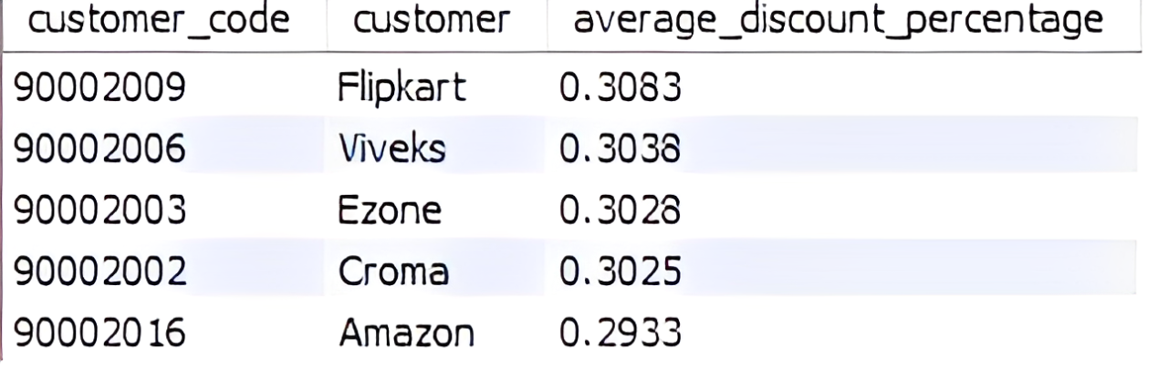
Question 6:
Generate a report which contains the top 5 customers who received an average high pre_invoice_discount_pct for the fiscal year 2021 and in the Indian market. The final output contains these fields,
customer_code
customer
average_discount_percentage
Output:

Slide 13
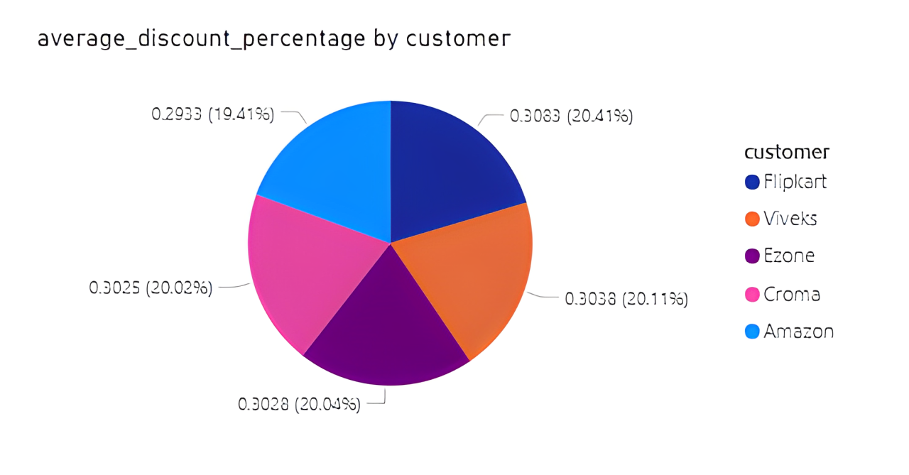
Insights:
*High Discount Customers (Flipkart, Viveks): These customers are receiving the highest average discounts, which may reflect strong purchasing power or aggressive negotiation tactics. Top management might need to evaluate whether these discounts are justifiable in terms of the overall revenue and profitability they bring in.
* Amazon has the lowest average discount percentage which could mean the company makes more profit from sales to Amazon compared to other customers.

Slide 14
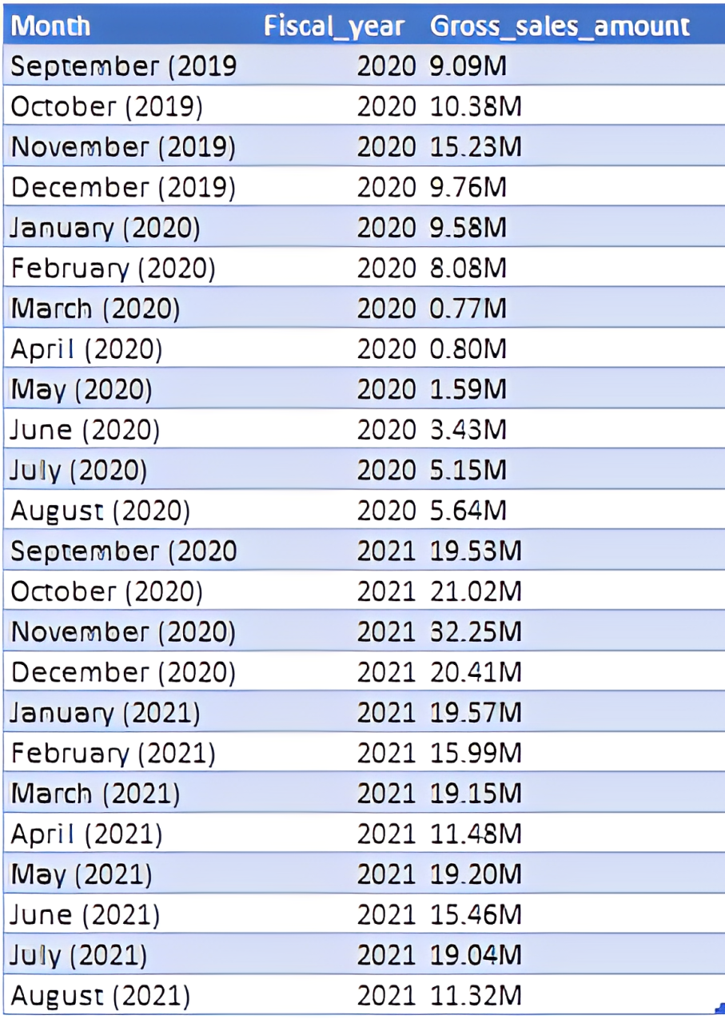
Question 7:
Get the complete report of the Gross sales amount for the customer “Atliq Exclusive” for each month. This analysis helps to get an idea of low and high-performing months and take strategic decisions.
The final report contains these columns:
Month
Year
sales Amount
Output:

Slide 15
Insights:
High-Performing Months:
November 2020 (32.45M): This month has the highest sales, likely due to seasonal factors like holiday promotions.
October 2020 (21.02M) and January 2021 (19.57M): Other peak months with significant sales figures.
Low-Performing Months:
March 2020 (0.77M) and April 2020 (0.80M): These months had the lowest sales, possibly due to impacts from the pandemic.
February 2020 (0.88M): Another low-performing month, potentially indicating seasonal slowness.
General Trends:
Sales generally peak in the last quarter of the year and early in the new year, likely driven by holiday shopping and new year promotions. Strengthening marketing and sales efforts during these peak periods could maximize revenue.
Significant dips in sales during early 2020 likely due to the COVID-19 pandemic.
Developing strategies to boost sales during traditionally low-performing months could help smooth out revenue fluctuations.
Understanding the factors that contributed to the 2021 recovery could inform strategies for sustaining growth.

Slide 16
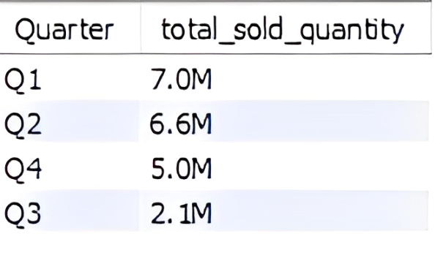
Question 8:
In which quarter of 2020, got the maximum total_sold_quantity? The final output contains these fields sorted by the total_sold_quantity,
Quarter
total_sold_quantity
Output:

Slide 17
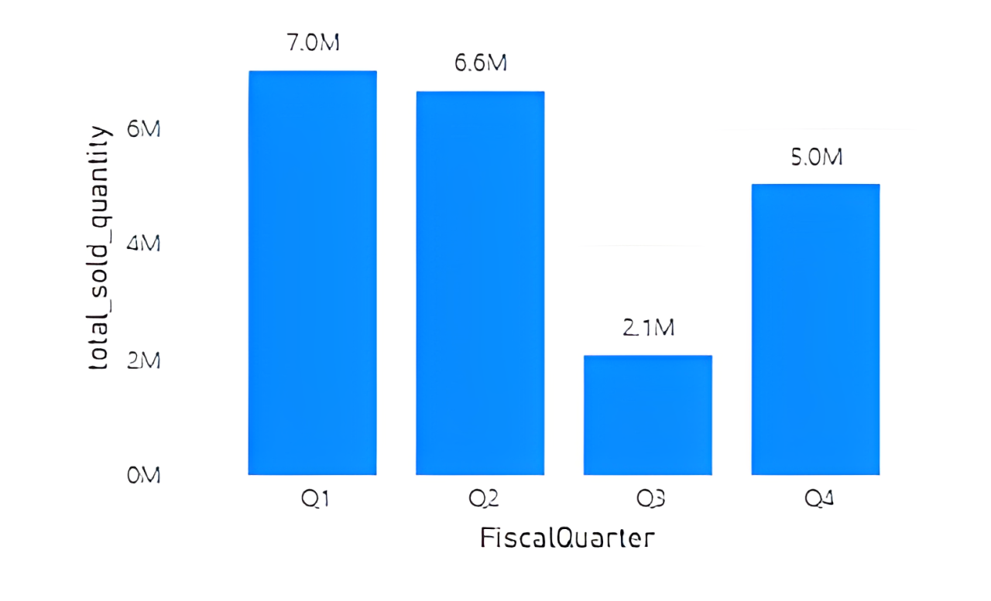
Insights:
*The chart shows that Q1 has the highest total sold quantity at 7.0 million units. This strong performance in the first quarter indicates a significant demand or successful sales strategy during this period.
*A sharp decline is observed in Q3, with sales dropping to 2.1 million units. This drastic reduction indicates potential challenges such as decreased demand, seasonality effects, or market saturation during this period.
*To achieve more consistent sales throughout the year, it may be beneficial to focus on understanding customer behavior, enhancing product availability, and adjusting promotional efforts during lower-performing quarters like Q3.

Slide 18
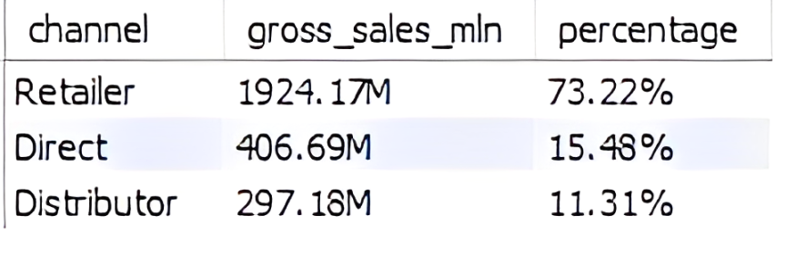
Question 9:
Which channel helped to bring more gross sales in the fiscal year 2021 and the percentage of contribution? The final output contains these fields,
channel
gross_sales_mln
percentage
Output:

Slide 19
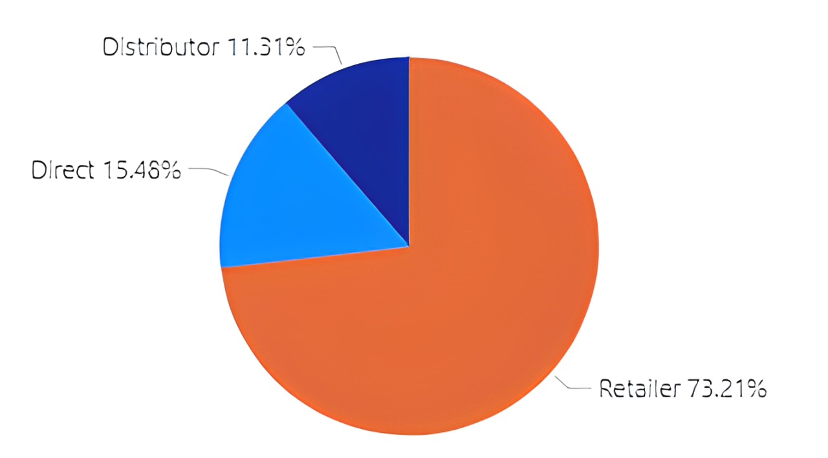
Insights:
*The Retailer channel is the most significant contributor to gross sales, accounting for 73.22% of the total sales. This suggests that the majority of the company’s revenue is driven by retail partnerships.
*The Direct sales channel, while contributing a smaller portion at 15.48%, presents an opportunity for growth. Discuss strategies to enhance direct sales, such as improving online presence, direct marketing, or customer engagement strategies. Increasing direct sales could provide higher profit margins since it might bypass intermediary costs.
*The distribution of sales across three channels shows a relatively diversified revenue stream. However, with such a heavy reliance on the retailer channel, there is a potential risk if any disruption occurs in that channel. Explore the possibility of balancing the sales distribution more evenly across the channels to mitigate risks.

Slide 20
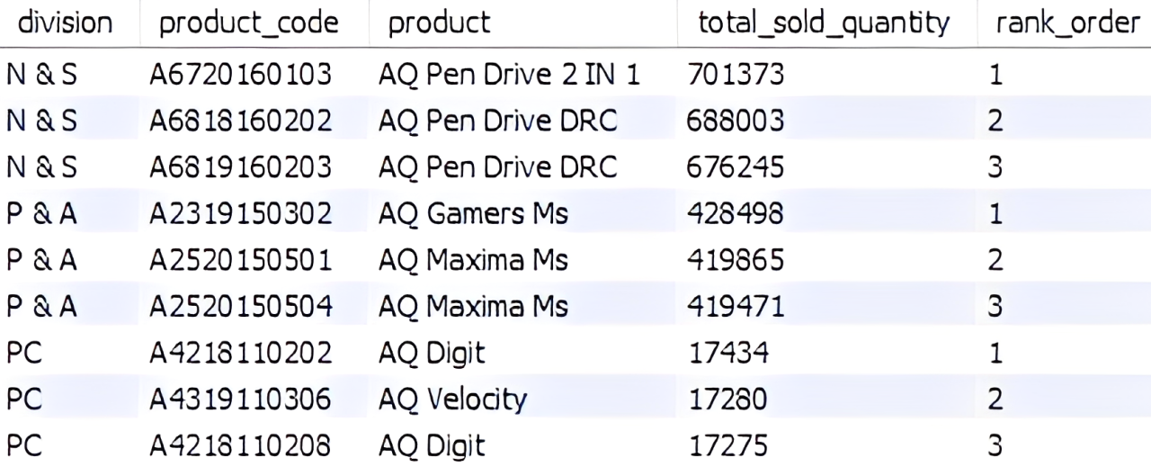
Question 10:
Get the Top 3 products in each division that have a high
total_sold_quantity in the fiscal_year 2021? The final output contains these fields,
division
product_code
product
total_sold_quantity
rank_order
Output:

Slide 21
Insights:
* Top Products: Every division has two identical products with varying performance.
*Division Leaders: The N & S division leads with the highest sales in AQ Pen Drive products.
*Improvement Areas: The PC division shows lower sales, suggesting room for growth.
*Growth Opportunities: Focus on strategies like bundling, upselling, and targeted marketing campaigns that could drive sales, particularly in underperforming divisions like PC.
*Leveraging High-Performing Products: Consider expanding the reach of the top-performing products, like those in the N & S division, into new markets or regions where they aren’t currently as strong. This could capitalize on existing success and drive further growth.

Slide 22
Thank You Presented by Prateek Sood

